Slide 1


SEVA MANDAL EDUCATION SOCIETY’S
SMT. KAMALABEN GAMBHIRCHAND SHAH
DEPARTMENT OF COMPUTER APPLICATIONS
UNDER
DR B.M.N COLLEGE OF HOME SCIENCE (AUTONOMOUS)
NAAC RE-ACCREDITED ‘A+’ GRADE WITH CGPA 3.69/4
UGC STATUS-COLLEGE WITH POTENTIAL FOR EXCELLENCE
338, R.A KIDWAI ROAD, MATUNGA, MUMBAI 400019.
2021-2022
LIVE PROJECT ON
“CATERING MANAGEMENT SYSTEM”
FOR
HOTEL VIRA AND CATERERS
Presented By:
Atmaja Prashant Pitale.

Slide 2
Catering Management System
FOR
HOTEL VIRA AND CATERERS

Slide 3
Company Profile
Name: Hotel Vira & Caterers
Location: Agashi Road, Virar (W)
Contact: 9323912096
Contact Person: Mr. Vikrant Jogle
Type of Company: Restaurant & Catering Business

Slide 4
Current System
Manual Order Booking and Scheduling
Spending hours creating raw material lists for each event
Tedious and Time-Consuming Client Menu Finalization Process
Limitations in Creating and Customizing Cater Menu

Slide 5
Proposed System
Event Management
Events
Client Menu
Shopping List
Vendors
Vendor Information
Vendor Purchase Details
Cater Menu
Create and Customize Menus, Set Price, etc.

Slide 6
Proposed System
Employee Management
Store details about Service and Contract-Based Employees
Recipe Book
Create and Store Recipes of Cater Menu, Update, Delete, etc.

Slide 7
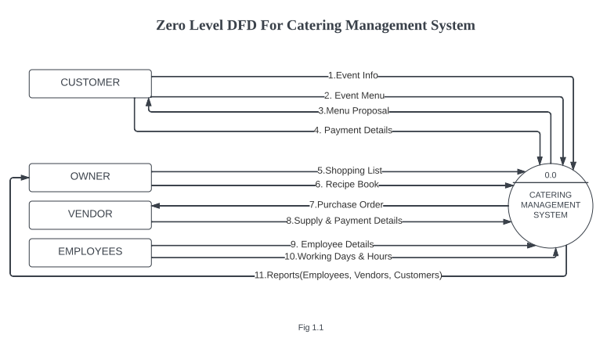

Slide 8
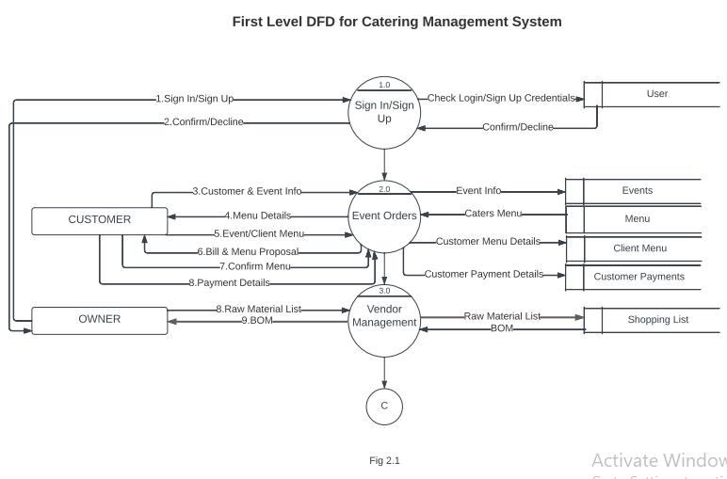

Slide 9
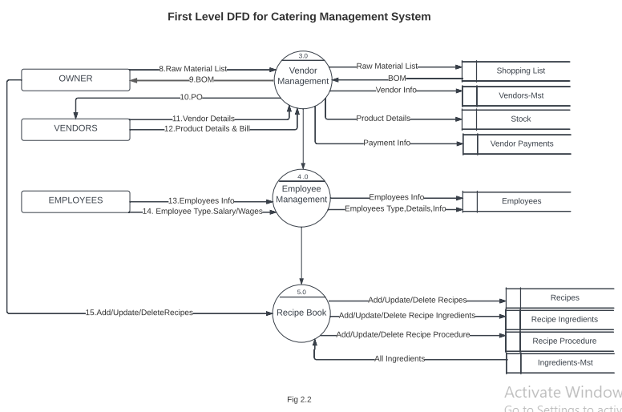

Slide 10
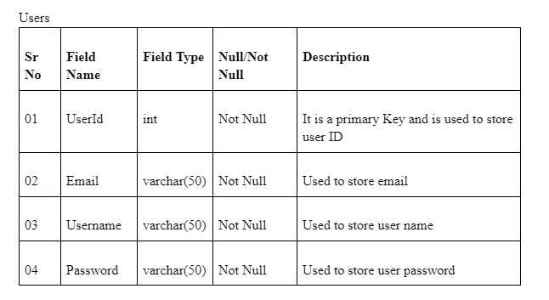
Database Design
Table - Users

Slide 11
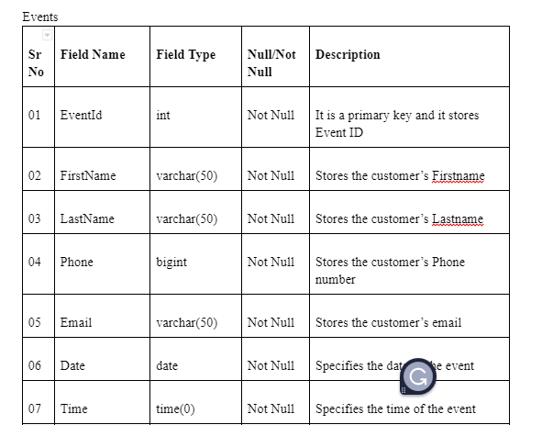
Database Design
Table - Events

Slide 12
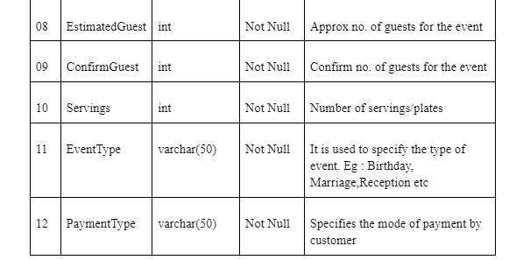
Database Design
Table - Events

Slide 13
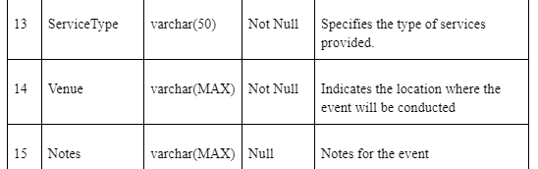
Database Design
Table - Events

Slide 14
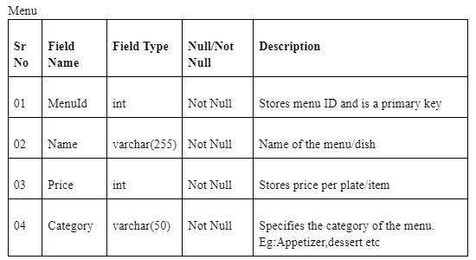
Database Design
Table - Menu

Slide 15
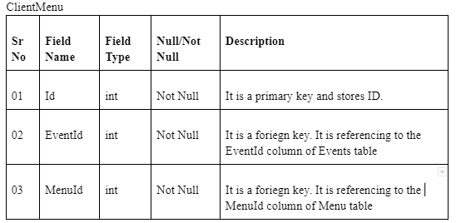
Database Design
Table - ClientMenu

Slide 16
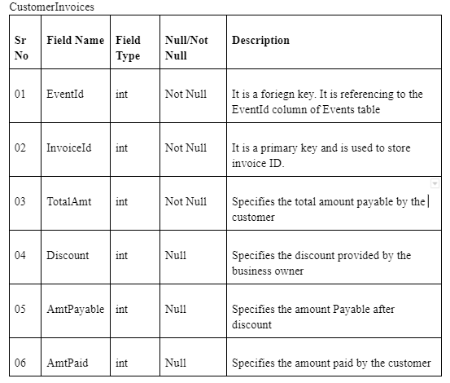
Database Design
Table - CustomerInvoices

Slide 17
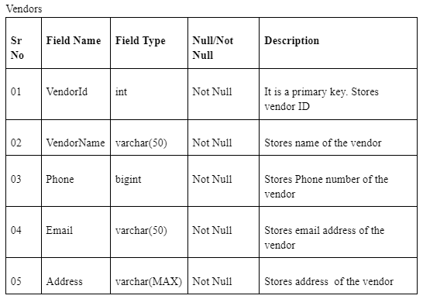
Database Design
Table - Vendors

Slide 18
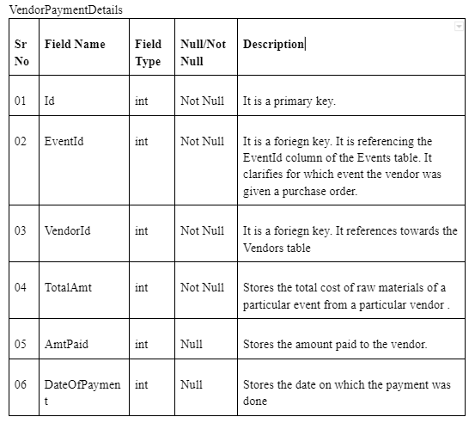
Database Design
Table - VendorPaymentDetails

Slide 19
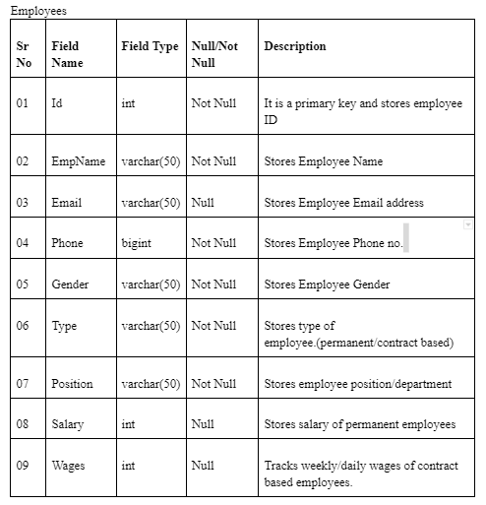
Database Design
Table - Employees

Slide 20
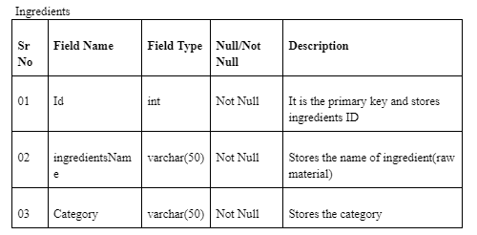
Database Design
Table - Ingredients

Slide 21
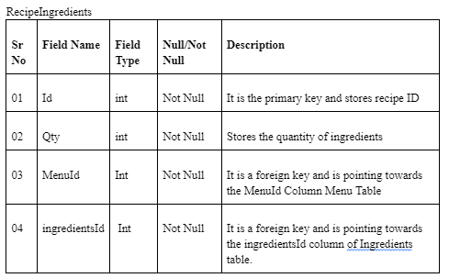
Database Design
Table - RecipeIngredients

Slide 22
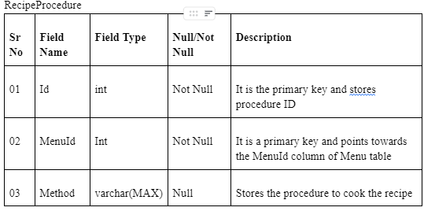
Database Design
Table - RecipeProcedure

Slide 23
Drawbacks of the Proposed System
Doesn't fully automate the creation of the shopping list process.
Limitations in tracking contract based employee working hours and wages

Slide 24
Future Enhancement
Provide a comprehensive scheduler with a color-coding system to understand upcoming events and their details.
Provide a food delivery tracking system for delivery based services
Provide more detailed and comprehensive employee management system

Slide 25
Biblography
https://www.c-sharpcorner.com/csharp-tutorials
https://stackoverflow.com/
https://www.flaticon.com/

Slide 26
Thankyou

Slide 27



